Slide 1
Pelvis and Perineum
Prof. Aranjan Karunanayake MBBS, DM, DOH&S, Dip.Tox, Dipin. Coun, D.Sp.Med, FSS, MBASEM (UK), MSc.SEM (UK)

Slide 2
Reproductive System Module Objectives
Pelvis and perineum.
Student should be able to
describe the bones of pelvis.
describe the differences between male and female pelvis.
describe the levatorani muscle.
describe the perineal membrane.
describe the superficial and deep perineal pouches.
describe the posterior perineum.
describe the ischiorectal fossa
Describe the structure and supply to the penis

Slide 3
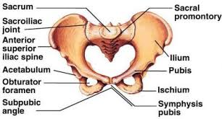
Functions of the pelvis-
Protects pelvic viscera.
Supports the weight of the body
Helps to walk reasonably well.
Provides attachment for muscles.
Provides a bony support for the birth canal.

Slide 4
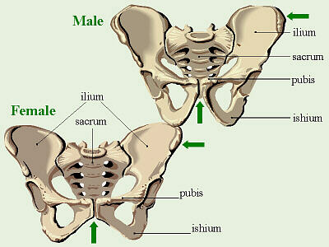
Male and Female pelvis
Differences between sexes-
Inlet- female oval shape., male heart shape.
Outlet- females larger. Ischial tuberosities everted. Males smaller. Ischial tuberosities inverted.
Pelvic cavity- More room in females. Less room in males. Walls parallel in females and directed inwards in males.
Pubic arch- females larger (> 90 degrees). Males narrower (< 90 degrees)
Muscle attachments- indistinct in females. Marked in males.

Slide 5
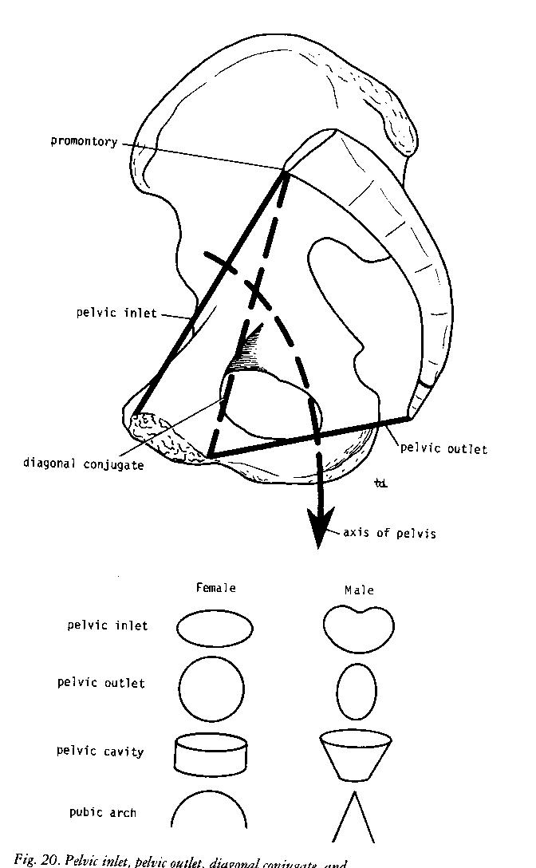
Differences Male and Female Pelvis
Pelvic inlet antero posterior diameter extends from upper part of pubic symphysis to upper part of sacral promontary.
Conjugate diameter extends from lower part of pubic symphysis to upper part of sacral promontary.

Slide 6
Structure of pelvic walls-
Made up of bones, muscle, and fascia.
Ant. Pelvic wall – bodies of pubic bones, symphysis pubis, pubic rami.
Post. Pelvic wall – sacrum, coccyx, piriformis, muscles and their covering pelvic fascia.
Lat. Pelvic wall – Innominate bones, obturator membrane, sacro tuberous and sacro spinuous ligaments, obturator internus muscle and its covering fascia.
Floor- Levatorani muscle and the fascia. Divides pelvis into main cavity and perineum.

Slide 7
Sacro iliac joint- Between sacrum and iliac bones. Strong synovial joint. Ligaments such as anterior and posterior sacro iliac ligaments and sacro spinuous and sacro tuberous ligaments support it. This joints transmits weight of the body from vertebral column to pelvis.
Symphysis pubis- Between two pubic bones. Fibro cartilaginous joint. No or very little movements.
Sacro coccygeal joint- Cartilaginous joint. Between last sacrum and first coccygeal. Fair amount of movements possible.

Slide 8
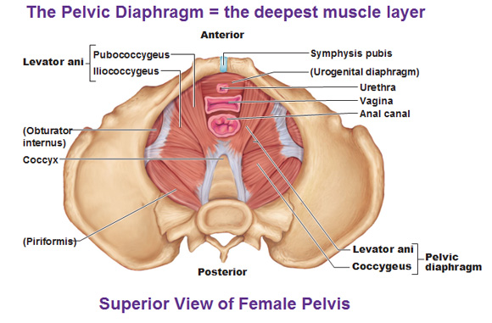
Pelvic diaphragm-
Made up of muscles and fascia.
Rectum, urethra and vagina pierces it.
Muscles are levatorani and coccygeus.
Levator ani- origins from back of pubis, fascia covering obturator internus and spine of ischium. It sweeps down and form series of loops around prostate/vagina and rectum. Inserts into perineal body, coccyx and reinforces external anal sphincter. Supplied by pudendal nerve.
It supports the pelvic floor, provides sphincter action on rectum and vagina. Helps to increase intra abdominal pressure.

Slide 9
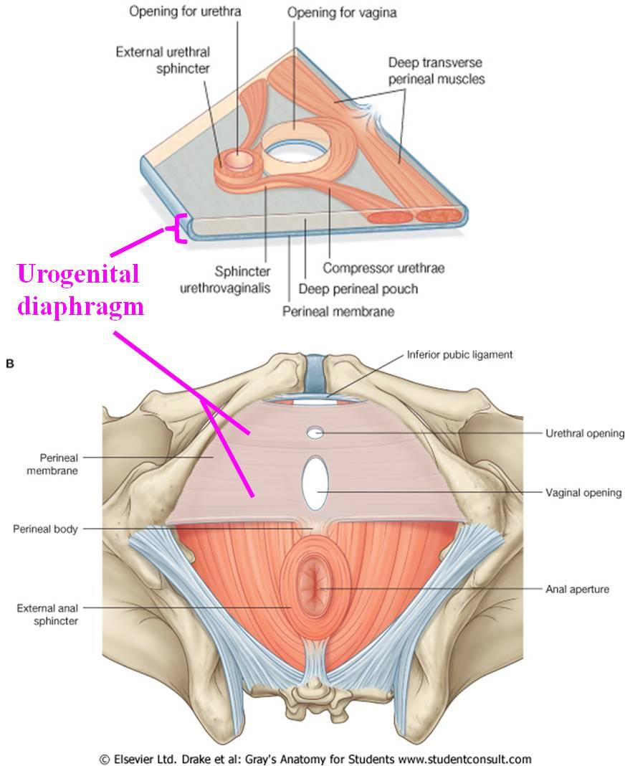
Perineum-
Lies below the pelvic diaphragm. Has 2 parts. Anterior (urogenital) and posterior perineum.
Anterior perineum (urogenital triangle)-
The space between two ischiopubic rami and an imaginary line joining the two ischial tuberosities. Perineal membrane is attached to the sides of this triangle.

Slide 10
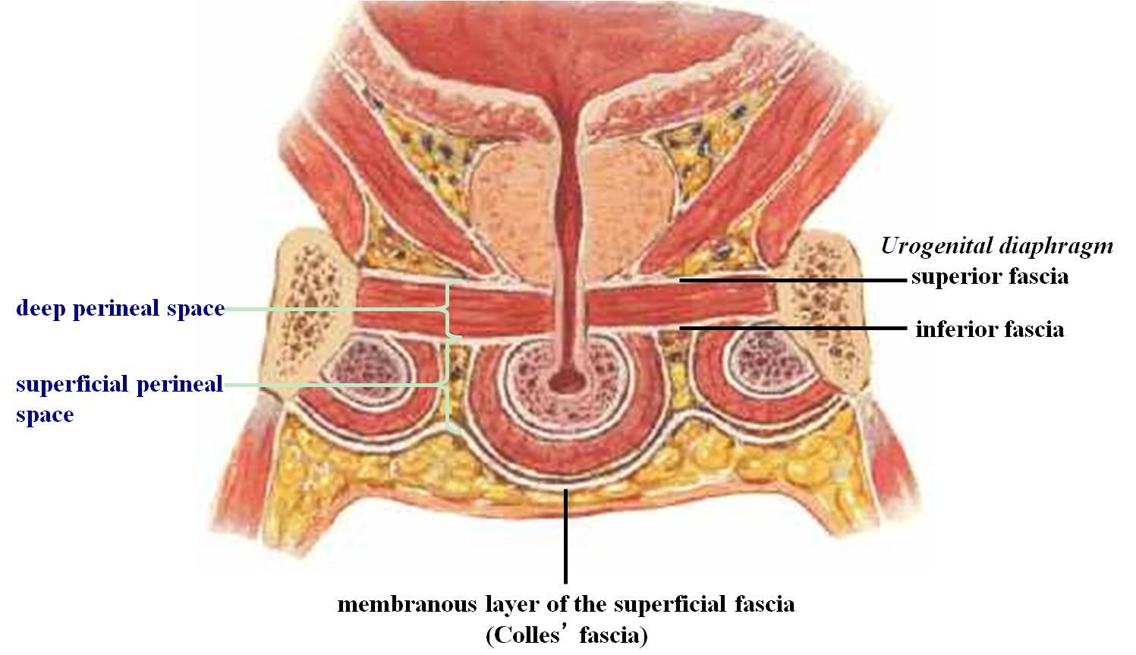
Superficial to this membrane- superficial perineal pouch.
Deep to this membrane- deep perineal pouch.
Urethra and in female the vajina pierces this membrane.

Slide 11
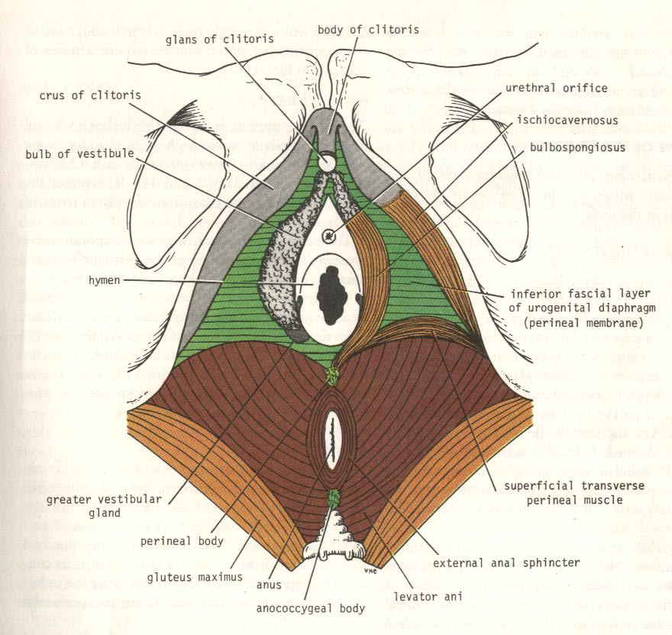
Deep perineal pouch-
Lies deep to perineal membrane.
External sphincter of urethra, two glands of cowper and deep transverse perineal muscles are found in it.
Superficial perineal pouch-
Lies superficial to the perineal membrane.
Bulbo-spongiosus, ischio-cavernosus and superficial perineal muscles are found in it.
Perineal body-
Fibro muscular node. Lies in midline at junction of anterior and posterior perineum. Gives attachment to external anal sphincter, bulbo-spongiosum, transverse perineal muscles and fibres of levator ani muscles.

Slide 12
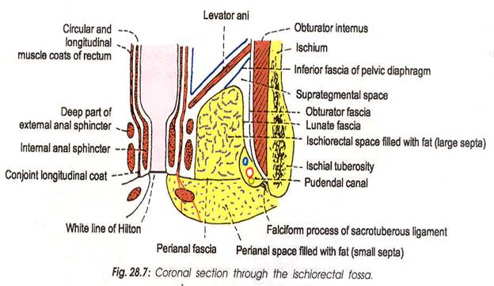
Posterior (anal) Perineum-
Lies between ischial tuberosities and coccyx.
Contains anus, superficial sphincters of anus, levator ani and ischiorectal fossae on each side.
Ischio rectal fossa-
Pyramidal shape space on either side of the anal canal. Medial border formed by fascia covering levator ani and lateral border formed fascia covering obturator internus. Posterior boundary sacro tuberous ligaments, urogenital perineum lies anteriorly. Floor is formed by skin and subcutaneous fat.

